Slide 1
On campus bowling alley & Sports Bar
By Katie Scheff and Kurt Mullins

Slide 2
Why should TU have a bowling Alley/Restaurant
Two of the three warehouses in the Pettibone establishment
Something to keep students on-campus
Bowling team and intramurals that can be held exclusively on campus
Bar and grill restaurant would give students an additional option to eat at on campus
Bowling events would be a positive by bringing in revenue for the University
For intramurals, campus activities, and athletic tournaments
The bar and grill attached, 16 Vizio T.V.’s, IPAD jukebox, 2 HD projectors, and lounge seating
The bar and grill keeps alcohol consumption on-campus(in walking distance)

Slide 3
Budgets and costs—Bowling Alley
Built through Fusion bowling (pinsetters, construction, scoring, shoes, under the lane ball return system, and bowling balls) | $400,000
2 Panasonic Projectors | $4,000
iPad Jukebox | $1,300
TV’s (for bowling alley & bar, 16 in total) | $6,215
Rollaway Bleachers | $690
Lounge seats | $1,500
Lounge sofas | $4,600
Total: $422,305

Slide 4
Budgets and costs—Sports Bar (estimatE)
Start-Up Costs
Expenses/labor/material $142,000
Rent for six months while waiting on a liquor license: $49,800 (assuming $8,300 a month) Liquor license and fees: $9,000 Equipment, construction, and demolition: $60,000 Signage: $1,000 Décor and glassware: $21,000 Training for six employees: $858 Initial liquor and food order: $6,000
Sound system: $1,000 Emergency funds: $50,000 Misc.: $2,000 TOTAL . . . . . . . $342,658
Total Budget= $765,000

Slide 5
Funding
Strictly through donations
Possible small fundraiser

Slide 6
Accommodations of our Facility
Technology
Parking
Restrooms and flooring
Maintenance issues
Facilitation Managers
Safety Concerns

Slide 7
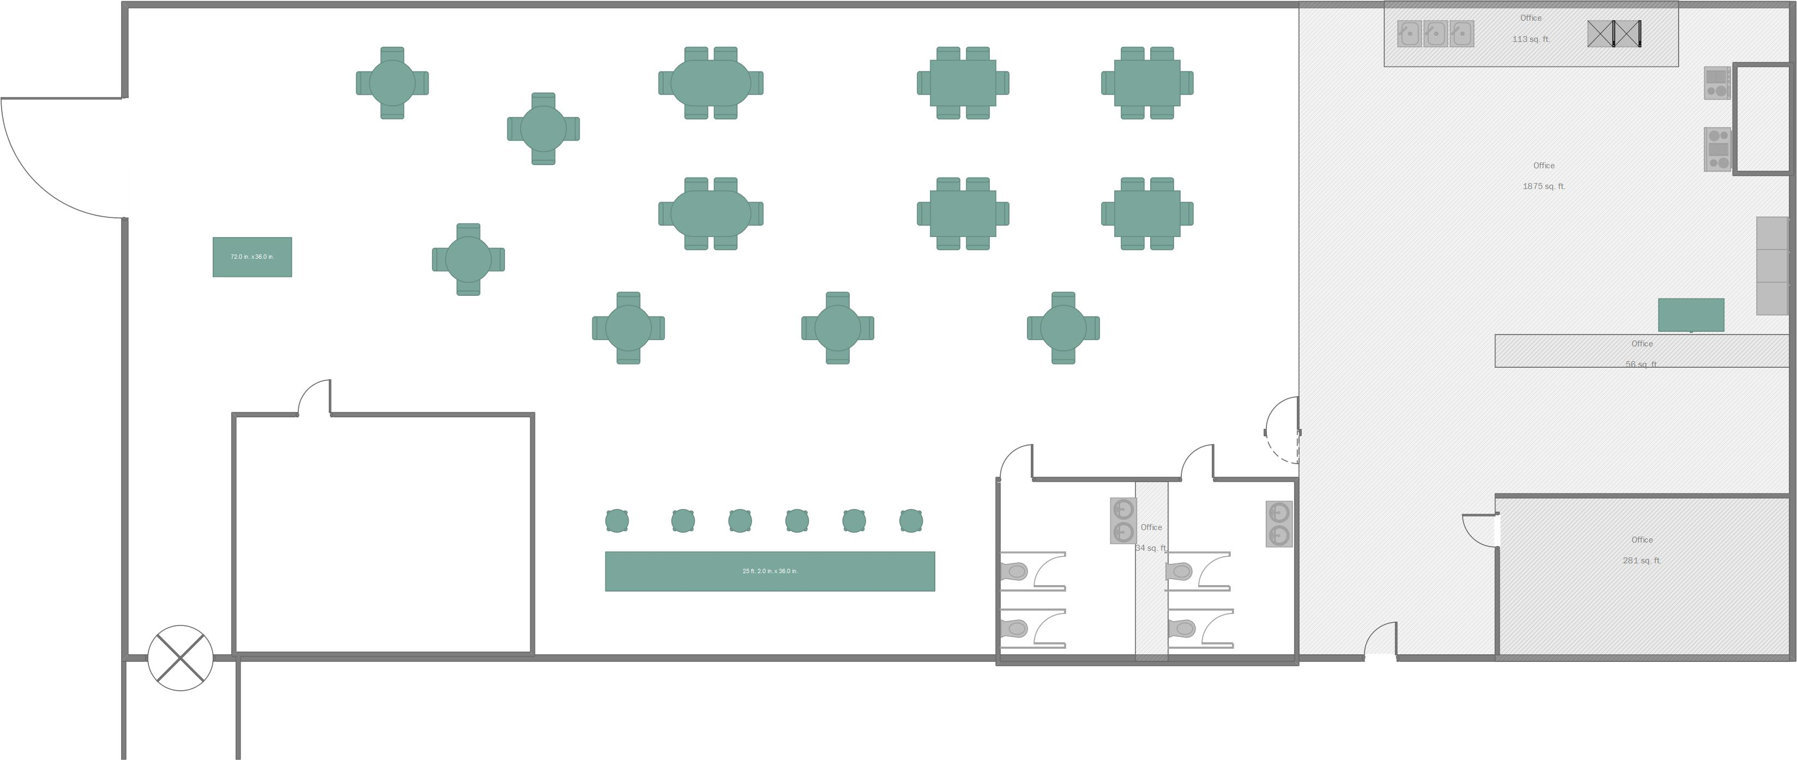
Blue Prints– Sports Bar

Slide 8
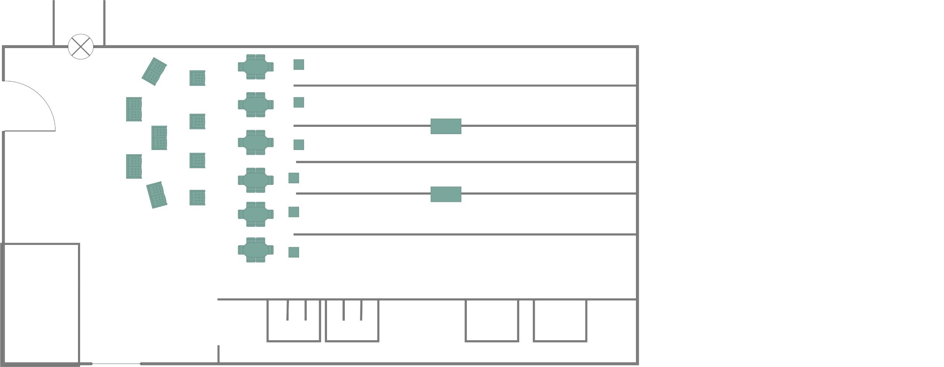
Blue Prints– Bowling Alley

Slide 9
Argument
Keep students on-campus
Less driving for students
Intramurals/bowling athletics stay on campus
Drinking stays on-campus
Competitive advantage over other institutions

